Slide 1

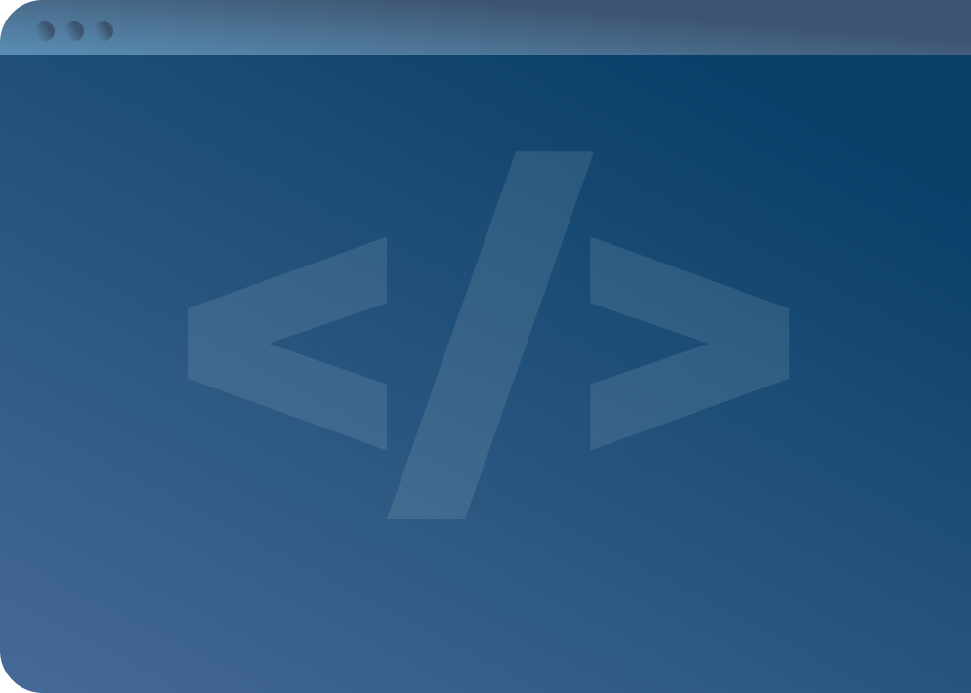

SOFTWARE DEVELOPMENT PROFESSIONAL PROGRAM
Variable Types, Operators, & Expressions

Slide 2





Variable Types, Operators, & Expressions
Learning Objectives
Create short bits of functional code with JavaScript.
Construct variables and perform mathematical operations on them.
Evaluate Boolean expressions and truthiness/falsiness.

Slide 3


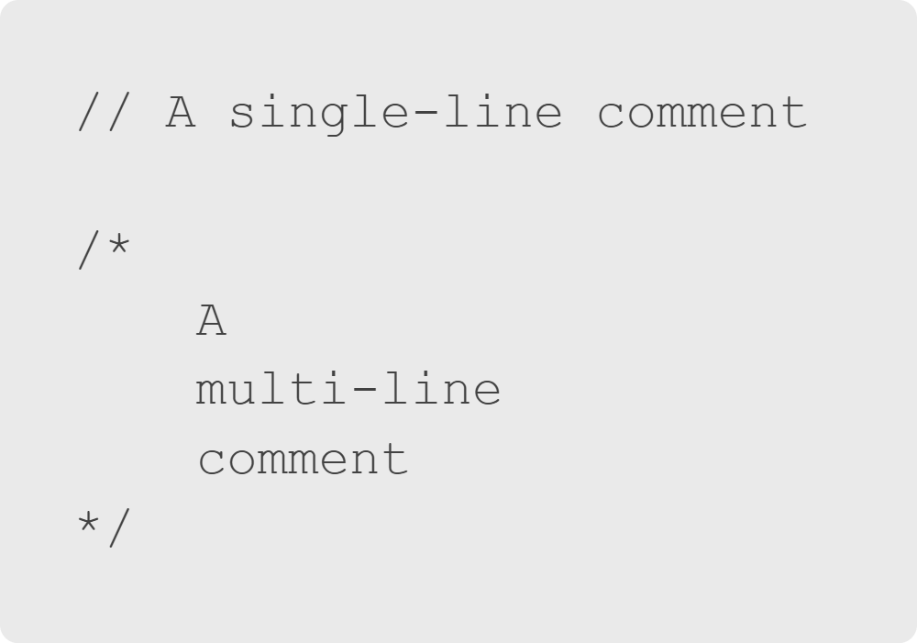
Variable Types, Operators, & Expressions
Comments
A comment is non-executable code for making notes in your code.
Notes:
Let's start with something simple: comments!
<< Exercise 1-- Comments >>

Slide 4
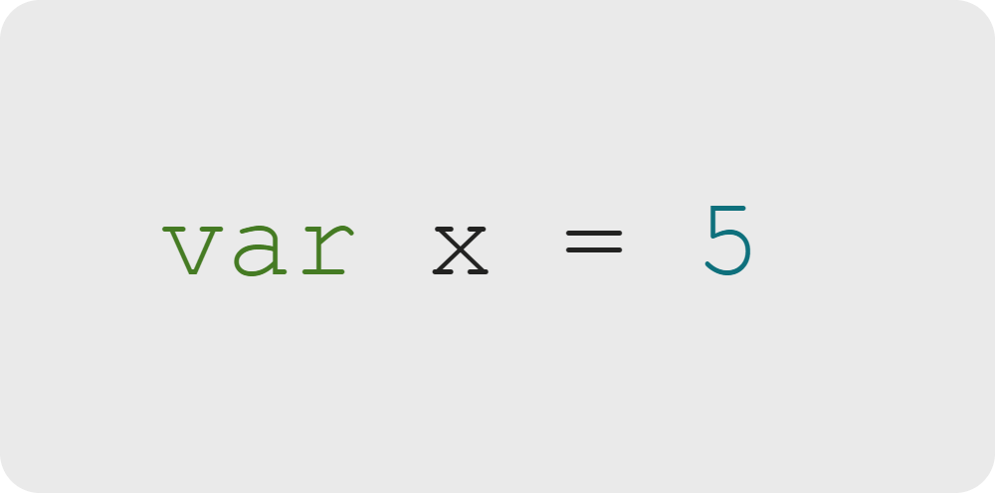
Variable Types, Operators, & Expressions
Declaring a Variable
Here we declare the numerical value 5 and assign it to the variable x.
Think of x as a box that holds a 5 in it.
Notes:
There can be other boxes that also have 5s in them, or we can later take out the 5 from this box and
replace it with something else.

Slide 5

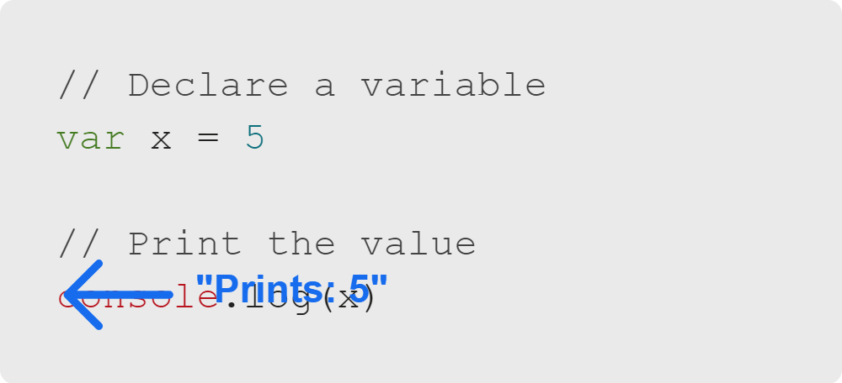
Variable Types, Operators, & Expressions
Printing Variable Values
Use console.log() to print values.
Put the variable you want to print inside parentheses.
Notes:
What if we want to see a variable? Remember, x is a box that is holding the value 5.
Simply put what you want to see printed inside parentheses.
<< Exercise 2-- Defining Variables >>

Slide 6

Variable Types, Operators, & Expressions
Opening Chrome DevTools
Chrome on MacOS
Chrome on Windows
Notes:
<< Allow learners a moment to access their Chrome DevTools. >>

Slide 7
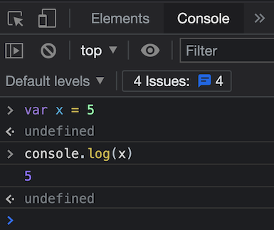
Variable Types, Operators, & Expressions
Using the DevTools Console
Let's write our first two lines of code!
Go to the "console" tab
Type var x = 5
Press enter
Type console.log(x)
Press enter
What do you see?
Notes:
<< Demonstrate typing the two lines of code into your Chrome DevTools and direct learners to follow along.
You can explain why the "undefined" prints if there's time or if someone asks.
Basically, Chrome is evaluating each statement. This won't happen when we run JS from a file. >>

Slide 8

Variable Types, Operators, & Expressions
Var Keyword: Let's Discuss
Questions About Making Variables
What does var mean?
What if you forget to write var?
Are there alternatives to var?
Notes:
Let's start with the var keyword. Make sure students have a grasp on what it means to declare a variable.
Inevitably, some student will ask about let/const so there is a segue to that with the last bullet point.

Slide 9
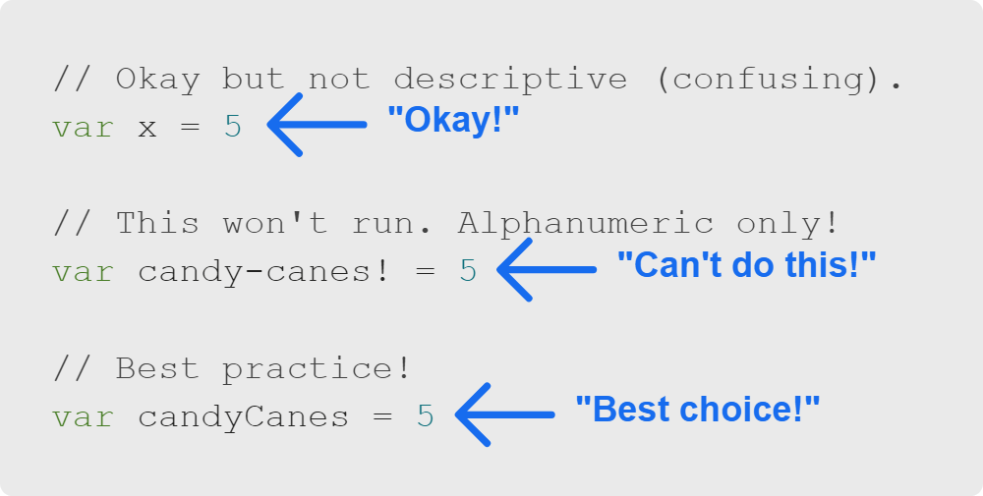
Variable Types, Operators, & Expressions
Naming Variables
Let's say we're counting candy canes. What's the best variable name?
Appropriate Variable Names
What does JavaScript accept as variable names?
What is the best practice for naming variables?
Notes:
<< Give learners a moment here to digest and pause to ask them what they think best practices for variable names are.
Some best practices to make sure to cover are:
- Variable names are written in camelCase
- Variable names don't start with a number
- Variable names are descriptive of the data they contain >>

Slide 10

Variable Types, Operators, & Expressions
Primitives Variables
JavaScript has only five primitive (basic) types:
Number: Numerical values of any kind
String: Any characters surrounded by single or double quotes
Boolean: True or false values
Null: A variable that purposely doesn't have a value
Undefined: A variable accidentally missing a value (usually)
Notes:
In JavaScript, there are primitive types and complex types (objects).
These definitions here are very much oversimplifications.
We will provide a few examples in the next slides.
If you feel your class is up for it, go into detail on what undefined is!

Slide 11
Variable Types, Operators, & Expressions
Primitives: Numbers and Strings
Numbers
Strings
5
-110
-0.3
0.00001
0
infinity
1.5
NaN
""
"Hello world!"
"What's your name?"
"12345!!!"
Notes:
Number is one of the five primitive types.
Number covers many different types of numbers, (e.g., negatives, decimals).
What are the other primitive data types besides numbers? One of them is "string".
Think of strings as basically anything you can type on a keyboard.
This may include alphanumeric characters, punctuation, whitespace, or even unicode characters such as emojis.
<< Exercise 3-- Variable Types >>
<< Exercise 4-- Defining Strings >>

Slide 12
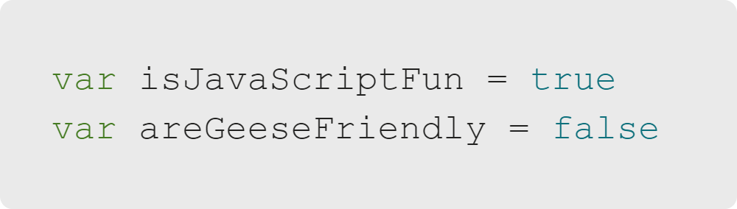
Variable Types, Operators, & Expressions
Primitives: Booleans
Booleans are true or false.
Tip: Both true and false are keywords in JavaScript.
Notes:
Because both true and false are keywords in JavaScript, there is no need to write them as strings.
Make sure they are NOT capitalized.

Slide 13
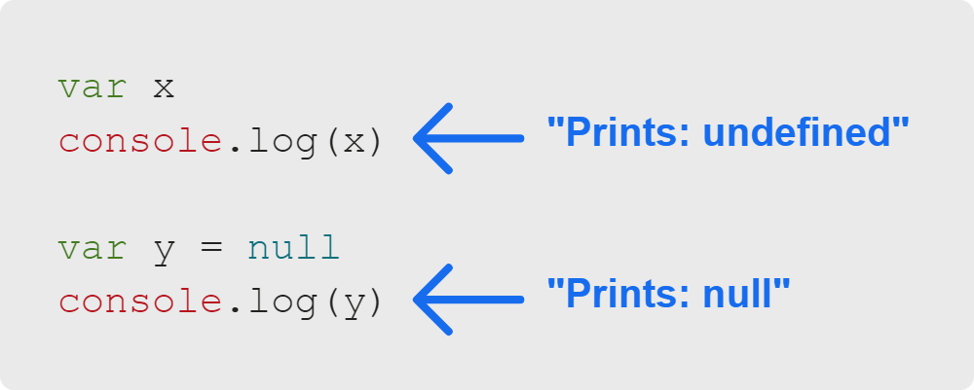
Variable Types, Operators, & Expressions
Primitives: Null & Undefined
Null and undefined have subtle differences.
Typically, null means a variable purposely has no value. Undefined generally means you forgot to assign a value.

Slide 14

Variable Types, Operators, & Expressions
Operators: Performing Actions on Variables
Operator | Purpose | Example
+ | Addition / Concatenation | 5 + 4
- | Subtraction | 8 - 1
* | Multiplication | 6 * 7
/ | Division | 9 / 3
% | Modulus (remainder) | 10 % 3
** | Exponent | 2 ** 4
Notes:
You may be familiar with mathematical operators such as "+" for addition, "-" for subtraction, etc.
In JavaScript, there are many operators, and some can act differently based on the type of variable.
Next is an example where the + operator acts differently based on whether it is being used with numbers or strings.

Slide 15

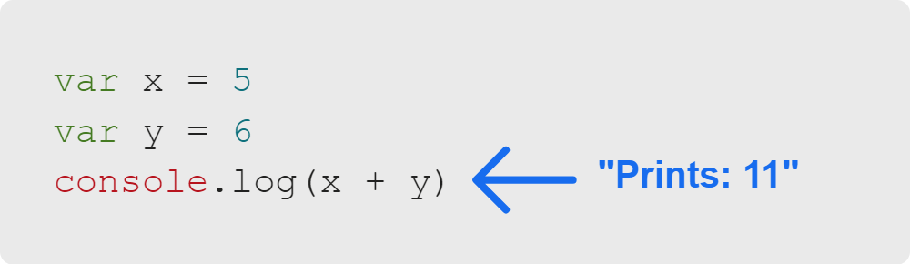
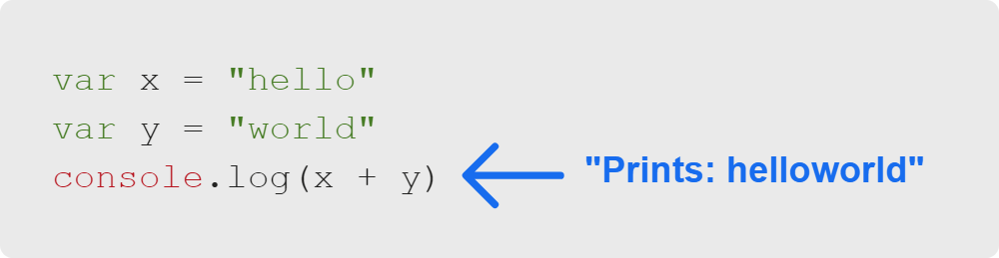
Variable Types, Operators, & Expressions
Addition vs. Concatenation With +
Adding Two or More Numbers
When used on two numbers, the + operator performs addition.
Concatenating Two or More Strings
When used on two strings, the + operator performs concatenation, which means combining them into a single string.
Notes:
Note the lack of space between "hello" and "world" once they are concatenated!
Also, note that concatenating two types (like a number with a string) will turn the whole thing into a string.
So, console.log(5 + "world") will print "5world".
<< Exercise 5-- Adding Numbers >>

Slide 16
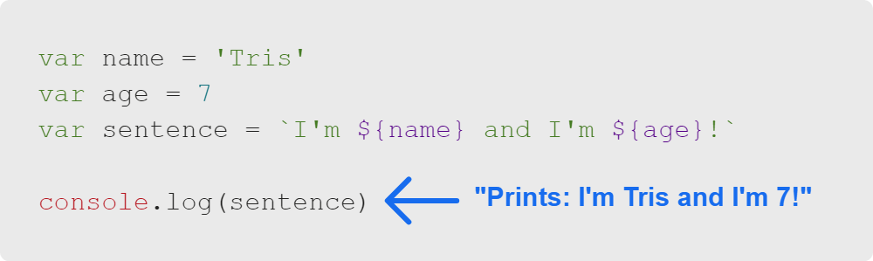
Variable Types, Operators, & Expressions
String Interpolation
Template literals are an alternative to concatenation.
It uses backticks instead of quotes.
It's most useful for using multiple variables within a string.
Notes:
This is especially useful when using multiple variables within a string.

Slide 17
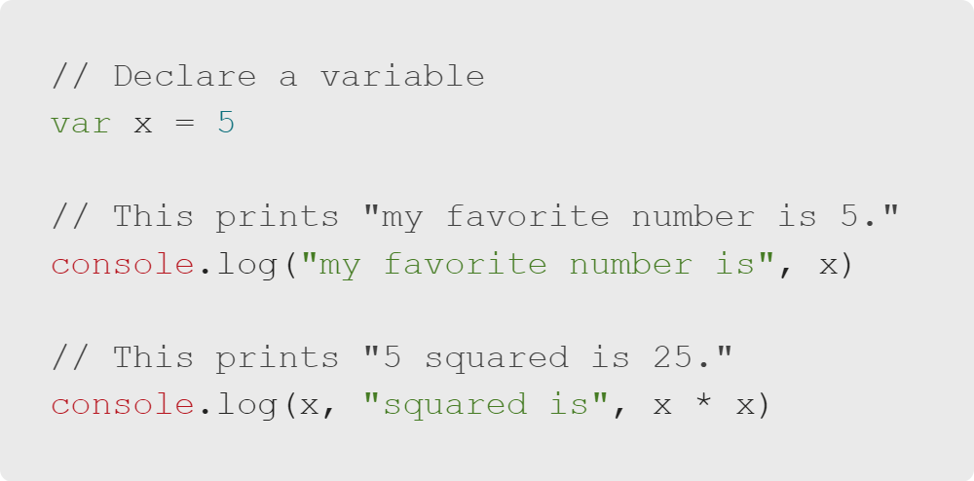
Variable Types, Operators, & Expressions
Advanced Printing
We know how to print a single value with console.log.
We've also seen that operations like 5 + 4 can resolve inside console.log statements.
Notes:
For example, comma separation of items will allow multiple items to be printed and insert a space automatically.

Slide 18
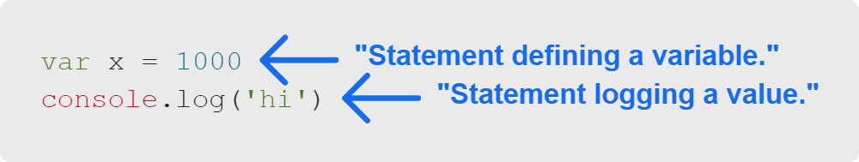
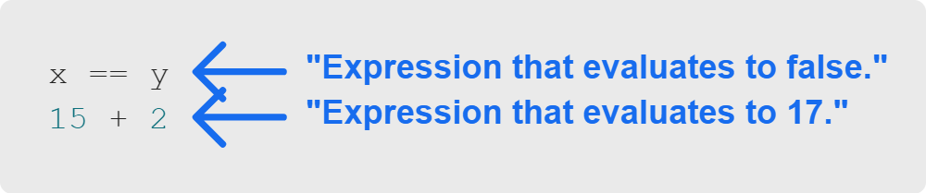
Variable Types, Operators, & Expressions
Statements vs. Expressions
What is the difference between a statement and an expression?
Statements are instructions for the computer to perform:
An expression resolves to a value:
Notes:
They are both referring to code, though!

Slide 19
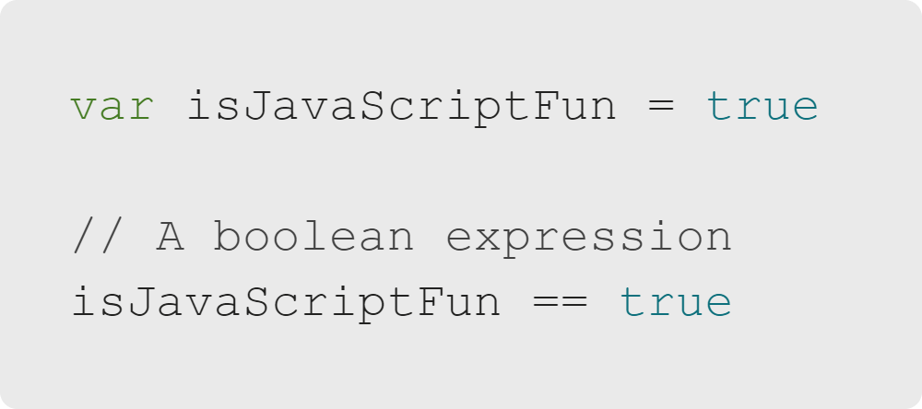
Variable Types, Operators, & Expressions
Boolean Expressions
Boolean expressions evaluate to booleans. Generally they contain:
Items to compare
A comparison operator
In the code example, can you name the operator being used?
Notes:
Not all expressions are boolean expressions.
For example, numerical expressions evaluate to numbers. Boolean expressions evaluate into Booleans.
We will practice with Boolean expressions more in our activity.
Programming code is usually full of conditionals like if/else statements, and Boolean expressions
are essential for conditionals to work.

Slide 20
Variable Types, Operators, & Expressions
Summary
What We've Covered:
Variable Types, Operators, & Expressions
JavaScript Comments
JavaScript Variables: Declarations and Naming
Primitive Types
Operators
Using console.log
Statements vs. Expressions
Boolean Expressions
Let's evaluate some expressions together!

